Slide 1
Virtual Machines

Slide 2
Overview
Fundamental idea – abstract hardware of a single computer into several different execution environments
  Similar to layered approach
  But layer creates virtual system (virtual machine, or VM) on which operation systems or applications can run
Several components
  Host – underlying hardware system
  Virtual machine manager (VMM) or hypervisor – creates and runs virtual machines by providing interface that is identical to the host
    (Except in the case of paravirtualization)
  Guest – process provided with virtual copy of the host
    Usually an operating system
Single physical machine can run multiple operating systems concurrently, each in its own virtual machine

Slide 3
History
First appeared in IBM mainframes in 1972
Allowed multiple users to share a batch-oriented system
Formal definition of virtualization helped move it beyond IBM
  A VMM provides an environment for programs that is essentially identical to the original machine
  Programs running within that environment show only minor performance decreases
  The VMM is in complete control of system resources
In late 1990s Intel CPUs fast enough for researchers to try virtualizing on general purpose PCs
  Xen and VMware created technologies, still used today
  Virtualization has expanded to many OSes, CPUs, VMMs

Slide 4

System Models
Non-virtual machine
Virtual machine

Slide 5
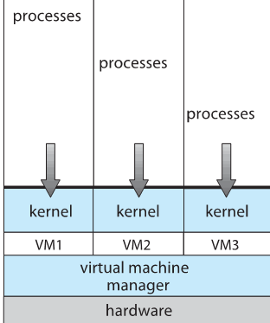
Building Block – Trap and Emulate
Host Machine – Kernel Mode
Guest Machine/Virtual Machine Software – runs on Kernel Mode
Virtual Machine – runs on User Mode
  So VM needs two modes – virtual user mode and virtual kernel mode
    Both of which run in real user mode
  Actions in guest that usually cause switch to kernel mode must cause switch to virtual kernel mode

Slide 6
Trap-and-Emulate (cont.)
How does switch from virtual user mode to virtual kernel mode occur?
  Attempting a privileged instruction in user mode causes an error -> trap
  VMM gains control, analyzes error, executes operation as attempted by guest
  Returns control to guest in user mode
  Known as trap-and-emulate
  Most virtualization products use this at least in part
User mode code in guest runs at same speed as if not a guest
But kernel mode privilege mode code runs slower due to trap-and-emulate
  Especially a problem when multiple guests running, each needing trap-and-emulate
CPUs adding hardware support, mode CPU modes to improve virtualization performance

Slide 7
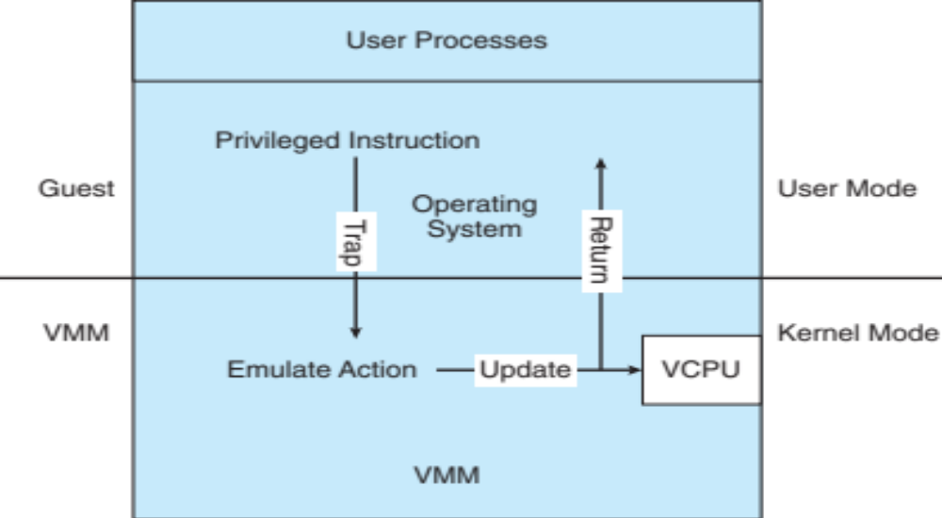
Trap-and-Emulate Virtualization Implementation

Slide 8
Implementation of VMMs
Vary greatly, with options including:
  Type 0 hypervisors - Hardware-based solutions that provide support for virtual machine creation and management via firmware
    IBM LPARs and Oracle LDOMs are examples
  Type 1 hypervisors - Operating-system-like software built to provide virtualization
    Including VMware ESX, Joyent SmartOS, and Citrix XenServer
  Type 1 hypervisors – Also includes general-purpose operating systems that provide standard functions as well as VMM functions
    Including Microsoft Windows Server with HyperV and RedHat Linux with KVM
  Type 2 hypervisors - Applications that run on standard operating systems but provide VMM features to guest operating systems
    Includeing VMware Workstation and Fusion, Parallels Desktop, and Oracle VirtualBox

Slide 9
Types of VMs – Type 2 Hypervisor
Less interesting from an OS perspective
  Very little OS involvement in virtualization
  VMM is simply another process, run and managed by host
    Even the host doesn’t know they are a VMM running guests
  Tend to have poorer overall performance because can’t take advantage of some HW features
  But also a benefit because require no changes to host OS
    Student could have Type 2 hypervisor on native host, run multiple guests, all on standard host OS such as Windows, Linux, MacOS

Slide 10
Examples - VMware
VMware Workstation runs on x86, provides VMM for guests
Runs as application on other native, installed host operating system -> Type 2
Lots of guests possible, including Windows, Linux, etc all runnable concurrently (as resources allow)
Virtualization layer abstracts underlying HW, providing guest with is own virtual CPUs, memory, disk drives, network interfaces, etc
Physical disks can be provided to guests, or virtual physical disks (just files within host file system)

Slide 11
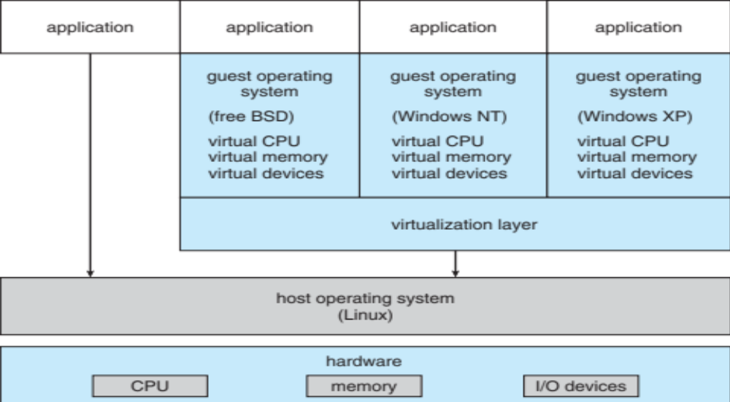
VMware Workstation Architecture

Slide 12
Types of VMs – Type 1 Hypervisor
Commonly found in company datacenters
  In a sense becoming “datacenter operating systems”
    Datacenter managers control and manage OSes in new, sophisticated ways by controlling the Type 1 hypervisor
    Consolidation of multiple OSes and apps onto less HW
    Move guests between systems to balance performance
    Snapshots and cloning
Special purpose operating systems that run natively on HW
  Rather than providing system call interface, create run and manage guest OSes
  Can run on Type 0 hypervisors but not on other Type 1s
  Run in kernel mode
  Guests generally don’t know they are running in a VM
  Implement device drivers for host HW because no other component can
  Also provide other traditional OS services like CPU and memory management

Slide 13
Types of VMs – Type 1 Hypervisor (cont.)
Another variation is a general purpose OS that also provides VMM functionality
  RedHat Enterprise Linux with KVM, Windows with Hyper-V, Oracle Solaris
  Perform normal duties as well as VMM duties
  Typically less feature rich than dedicated Type 1 hypervisors
In many ways, treat guests OSes as just another process
  Albeit with special handling when guest tries to execute special instructions

Slide 14
Types of VMs – Type 0 Hypervisor
Old idea, under many names by HW manufacturers
  “partitions”, “domains”
  A HW feature implemented by firmware
  OS need to nothing special, VMM is in firmware
  Smaller feature set than other types
  Each guest has dedicated HW
I/O a challenge as difficult to have enough devices, controllers to dedicate to each guest
Sometimes VMM implements a control partition running daemons that other guests communicate with for shared I/O
Can provide virtualization-within-virtualization (guest itself can be a VMM with guests
  Other types have difficulty doing this

Slide 15
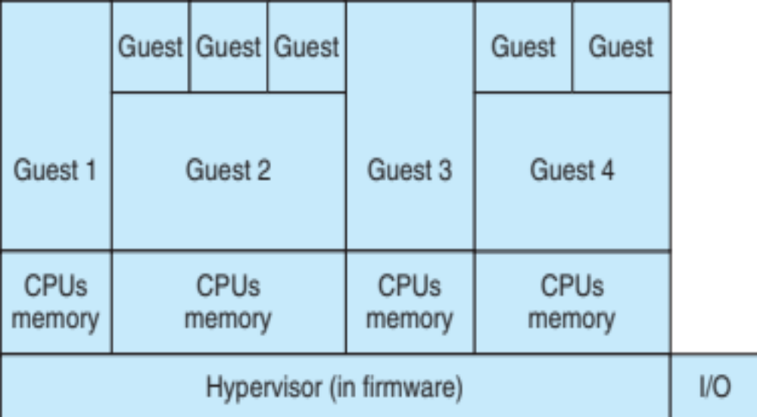
Type 0 Hypervisor

Slide 16
Advantages
Threat Isolation: Host system protected from VMs, VMs protected from each other
  I.e. A virus less likely to spread
  Sharing is provided though via shared file system volume, network communication
Backup & Recovery: Freeze, suspend, running VM
  Then can move or copy somewhere else and resume
  Snapshot of a given state, able to restore back to that state
    Some VMMs allow multiple snapshots per VM
  Clone by creating copy and running both original and copy
Better efficiency: Great for OS and cybersecurity related research, better system development efficiency.
Saves Money: Run multiple, different OSes on a single machine
  Consolidation, app dev, …

Slide 17
Disadvantages
Compromised performance: Host and guest, all share limited resources
Complexity: difficult to work compared to physical machines
Risk: All in one place. If host fails, then its VMs also fails. Otherwise called as “Single point of failure”

Slide 18
Thanks

